Slide 1




Coastal Climate Change & Adaptation
Dan Lane, IOI-Canada,
Co-Director – C-Change (Canada)
Professor Emeritus,Telfer School of Management, University of Ottawa
Presentation to the China- ASEAN Advanced Academy on Oceans Law & Governance 2, NISCSS Haikou, Hainan
PART 1 – Morning, November 12, 2016

Slide 2
Knowledge & Lessons
Overall theme: Climate Change Adaptation & Problem Solving
  Accepting the need for action on climate change
  Scientific method of problem solving
How to identify issues and prepare for adapting to coastal climate issues?
  Profiling community, region, nation and setting priorities
  Assessing vulnerability
What are possible adaptation decisions?
  Generalization of strategy options
How to make practical adaptation decisions in your local, regional, national coastal environments?
  Application of decision preference tools, decision analysis
  Course module assignments

Slide 3
Coastal Climate Change & Adaptation – Outline
PART I - Morning
Introduction
Challenges for the 21st Century – Coastal Zones
Understanding Adaptation Needs – Profiling
Pillars of Sustainability – Reflecting Importance**
PART II - Afternoon
Vulnerability Assessment
Estimating Coastal Impacts
Adaptation Problem Solving and Strategy Options
Evaluating Decisions**
Climate Change Governance
**Class Assignment

Slide 4
1. Introduction

Slide 5
Objective: Adaptation Problem Solving
Profile the Community (Problem Definition & Data)
  GIS, local issues, key participants, identify community preferences, pairwise comparison (tradeoffs) - AHP
Assess Vulnerability “hotspots” (Data Analysis)
  Determine potential impacts based on historical events, develop adaptation alternatives and options, costs
Simulate Strategic Systems (Modelling & Analysis)
  System dynamics modelling, strategic planning period
Evaluate Strategy Alternatives
  Apply indices for Vulnerability, Resilience, Adaptive Capacity
Recommend, Implement & Monitor

Slide 6
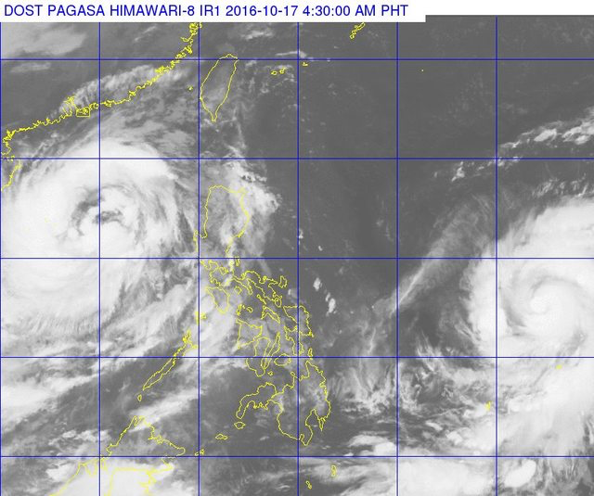
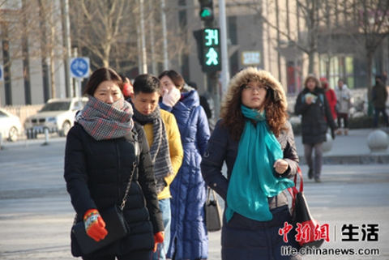
Weather versus Climate
The difference between weather and climate is a measure of time. Weather is what conditions of the atmosphere are over a short period of time, and climate is how the atmosphere "behaves" over relatively long periods of time.
Climate: temperature anomalies over time, El Nino effects, sea level rise, erosion, severe storms, storm surge(NASA website)
Weather: January 2016 cold spell in China: Beijing, Shanghai + “90% of China”, 30-year lows:
“This has led to an overload of the power grids, leaving around 150-thousand households without power in the cities of Nanchang and Jiujiang. …forecasters say the current weather system is unlikely to bring the same winter storms which battered much of China in 2008. Heavy snow, ice and cold temperatures caused extensive damage throughout the region back then, disrupting transportation for thousands during that year's Spring Festival travel season.” (CRI English News website)

Slide 7
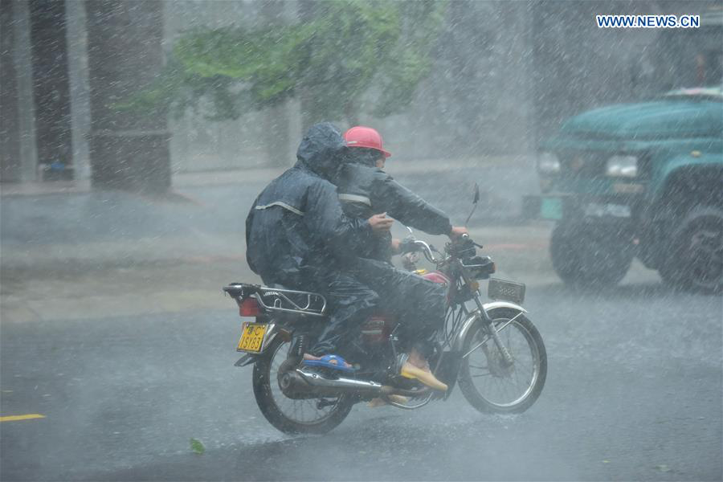
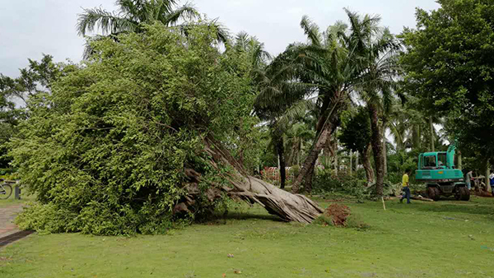
Hainan & Typhoons
Tour of Hainan, October 25, 2016 (http://velonews.competitor.com/2016/10/news/road/tour-hainan-survives-two-typhoons_423522 )
500,000 evacuated as Typhoon Sarika hits Hainan, Source: Xinhua (Shanghai Daily News) October 19, 2016 (http://www.shanghaidaily.com/nation/500000-evacuated-as-Typhoon-Sarika-hits-Hainan/shdaily.shtml )
Typhoon Sarika brings heavy toll in Hainan, Source: China Daily News, October 19, 2016 (http://africa.chinadaily.com.cn/china/2016-10/19/content_27112399.htm ) ¥4.56 billion (US$676.3 million)
  “Sarika, the twenty-first typhoon this year, seriously affected the life of more than 1.55 million people as it wreaked havoc in Haikou, the provincial capital, as well as Sanya and Danzhou. More than 2,600 rooms collapsed and about 81,700 hectares of crops were hit, leaving 17,000 hectares certain to suffer total failure this year, according to initial statistics from the Ministry of Civil Affairs.”

Slide 8
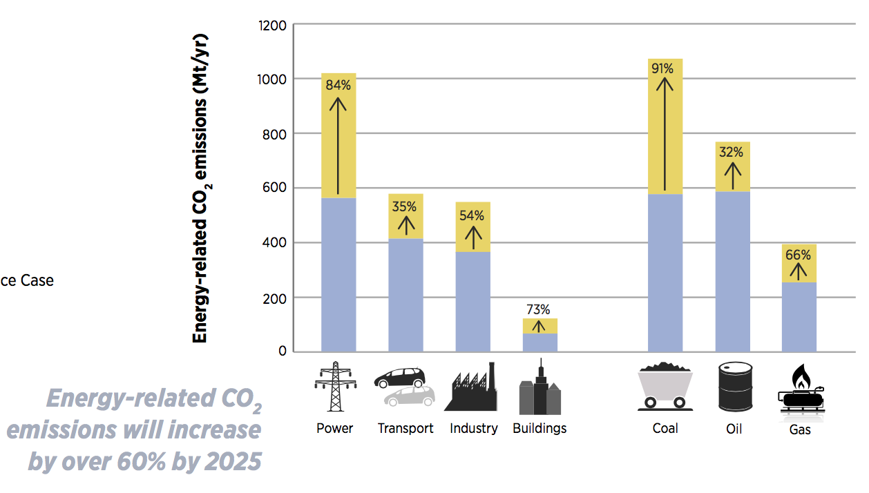
ASEAN and Climate Change
From the ASEAN Centre for Energy (ACE) Remap 2030 report (October 27, 2016):
External costs related to air pollution from the combustion of fossil fuels will increase by 35%, from USD 167 billion annually in 2014 to USD 225 billion in 2025. This would equal around 5% of the ASEAN region’s gross domestic product (GDP) in 2025. Therefore, the region will see rising costs for energy supply, as well as rising costs from the negative effects of greater fossil fuel use in increasingly urban societies.

Slide 9
China and Climate Change
China’s 13th five year plan (FYP)
  released in March 2016 and covers the period up to 2020. The headline targets are to reduce energy intensity by 15 percent and carbon intensity by 18 percent compared to 2015 levels. In addition, energy consumption will be capped at 5 billion tons of coal equivalent, and the share of primary energy consumption from non-renewable sources will increase to 15 percent. The increased carbon intensity goal means that China would reach, or potentially exceed, its Copenhagen pledge to reduce carbon intensity 40-45 percent below 2005 levels.
  (Source: Center for Climate and Energy Solutions http://www.c2es.org/international/key-country-policies/china)
China ratifies Paris climate change agreement ahead of G20
  (Source: The Guardian, September 3, 2016https://www.theguardian.com/world/2016/sep/03/china-ratifies-paris-climate-change-agreement)
Donald Trump, China, ASEAN and Climate Change…:
“Donald Trump’s election could mean ‘planetary disaster’, environmentalists warn as UN climate summit begins” – The Independent, November 7, 2016
  (Source: http://www.independent.co.uk/environment/donald-trump-election-us-global-warming-climate-change-fossil-fuels-petrol-oil-a7402276.html )

Slide 10
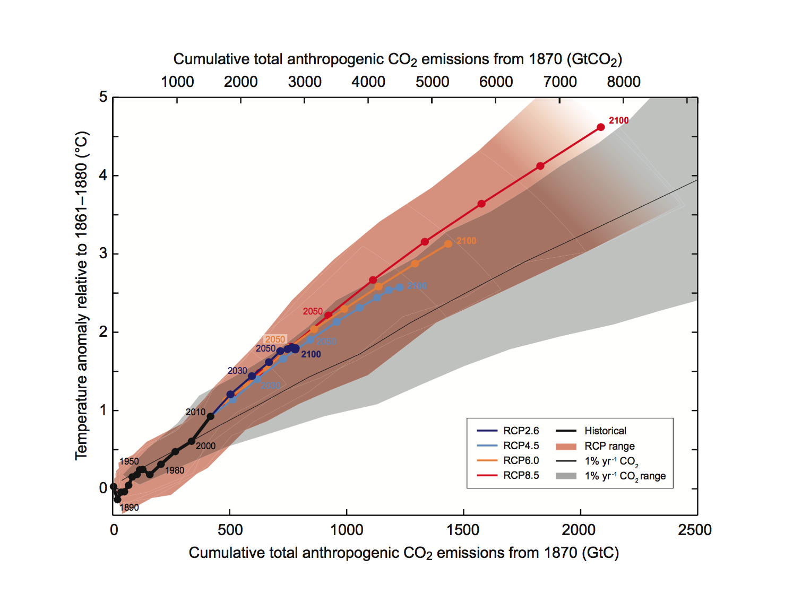
Source: IPCC, 2013: Summary for Policymakers. In: Climate Change 2013: The Physical Science Basis.
Contribution of Working Group I to the Fifth Assessment Report of the Intergovernmental Panel
on Climate Change [Stocker, T.F., D. Qin, G.-K. Plattner, M. Tignor, S.K. Allen, J. Boschung, A. Nauels,
Y. Xia, V. Bex and P.M. Midgley (eds.)]. Figure SPM 10, p.28
Cambridge University Press, Cambridge, United Kingdom and New York, NY, USA.

Slide 11
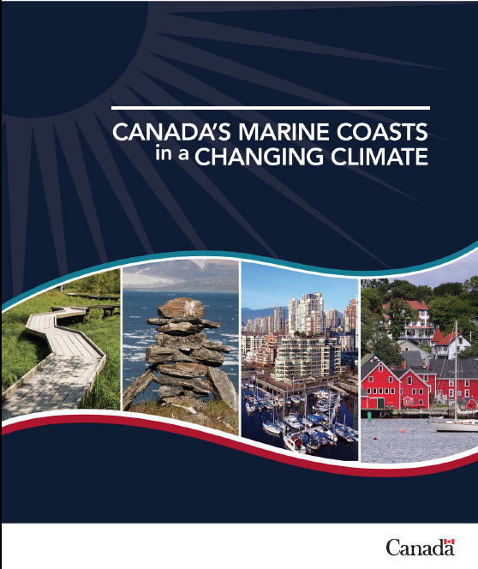
The Changing Climate
Global evidence – IPCC
Canada’s national coasts – 3 oceans; Natural Resources Canada government (June 2016)

Slide 12
Climate Change Impacts and Adaptation
ASSESSMENT OF CANADA’S MARINE COASTS
-Natural Resources Canada document in development (2016)
Warming – air temperatures, land surface, oceans trend attributed to global warming due to increasing GHGs in the atmosphere
Increased frequency an severity of coastal storms – events of extreme precipitation, high winds and seasonal storms, storm surge aggravated by sea-level rise, extended periods of drought
More human development in coastal areas – higher pollution, GHG emissions, and maladaptation practices along the coastal zones.

Slide 13
Guangdong coast evidence
Guangdong coast – Guangzhou loss potential from sea level rise is world’s highest (World Bank, China Climate Science Report 2015, Dec 2015)
http://www.theglobeandmail.com/news/rising-waters-prompt-chinas-sea-change-onclimate/article27608966/

Slide 14
2. Coastal Climate Challenges

Slide 15
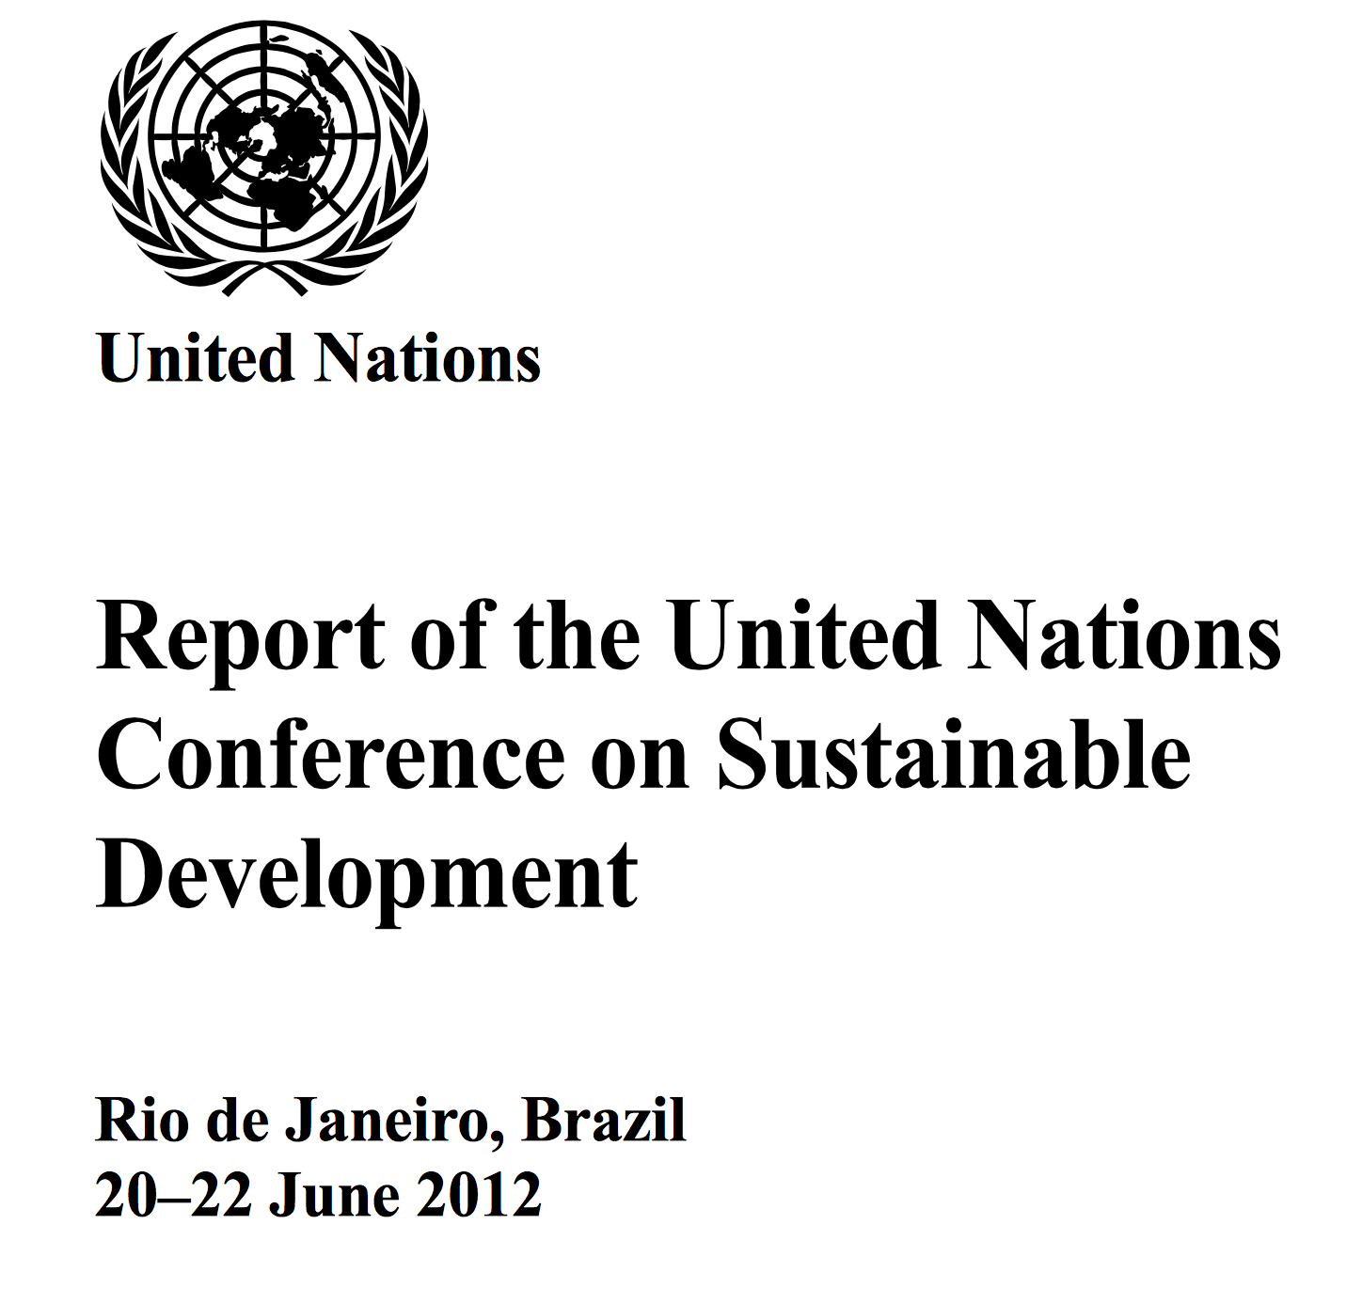
Climate Challenges for the 21st Century

Slide 16

Editors:
Juan Baztan, Omer Chouinard, Bethany Jorgensen, Paul Tett, Jean-Paul Vanderlinden and Liette Vasseur
ISBN: 978-0-12-802748-6

Slide 17
Challenges for the 21st Century
Laudato Si’
Rio +20
Identify community priorities
Cede authority to local communities, municipalities
Measure, track, and exercise preparedness
Implement the precautionary approach and plan strategically
Build an education legacy
...dialogue that includes everyone
We require a new and universal solidarity.
drawing on the results of the best scientific research available today (Chapter 1)
Article 186 and the Rio Declaration (1992)
change is impossible without motivation and a process of education (Article 15)

Slide 18
3. Understanding Adaptation Needs - Profiling Coastal Communities

Slide 19
Understanding Adaptation Needs
Profiling Coastal Communities
Assessing Coastal Vulnerabilities
Determining Relative Importance of Sustainability Pillars

Slide 20
The Importance of Context –
Examples from C-Change
Isle Madame – coastal community, aging and declining population
Charlottetown – coastal community; location on 3 rivers; provincial capital city
Grande Riviere, Trinidad – tourism development versus conservation

Slide 21
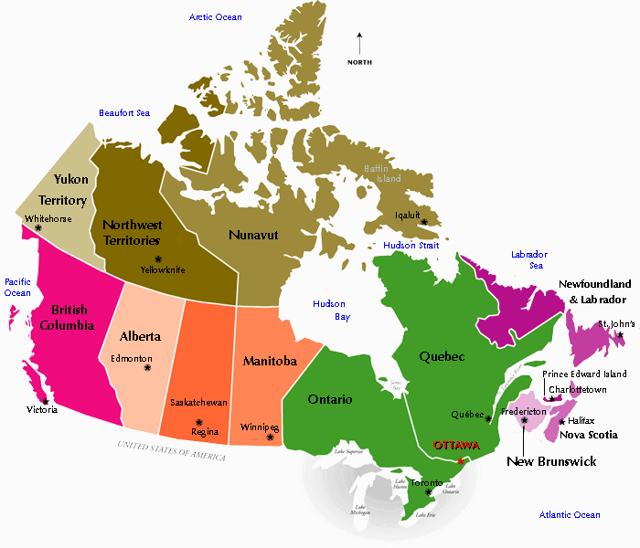
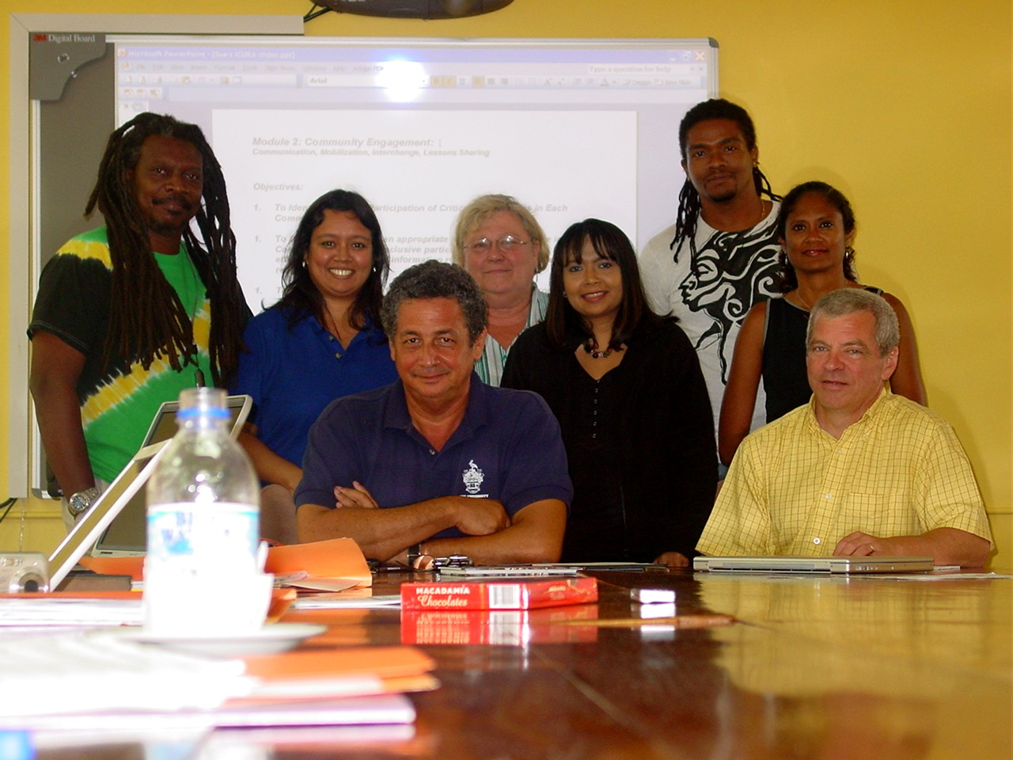

ICURA Team Members
Caribbean Workshop, Sept 3-7, 2008
Gibsons
Isle Madame

Slide 22
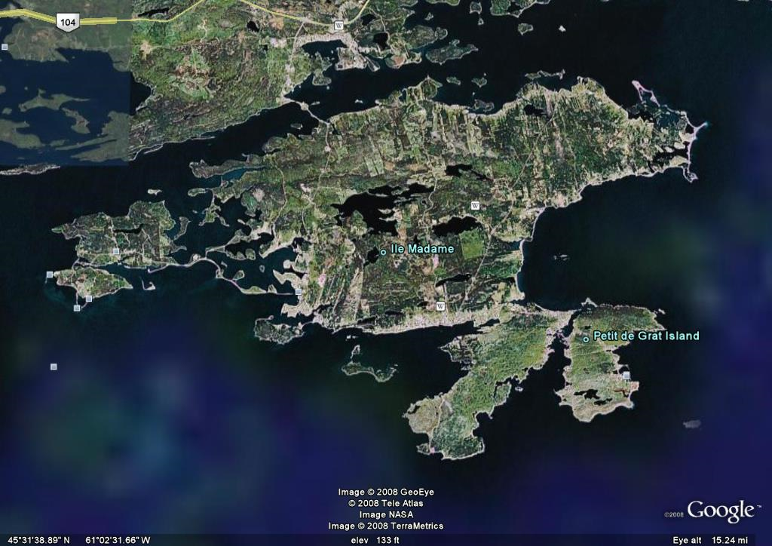
Isle Madame (Source: Google Earth 2010)

Slide 23
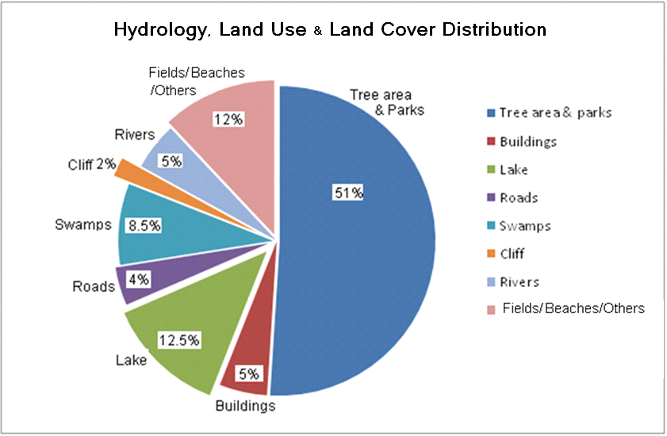
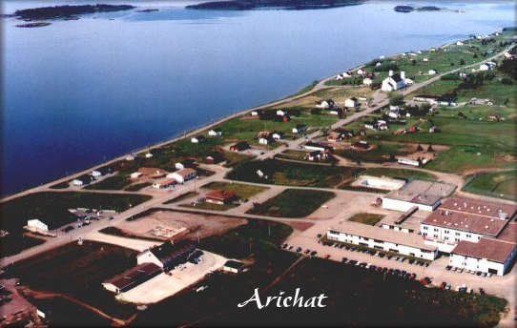
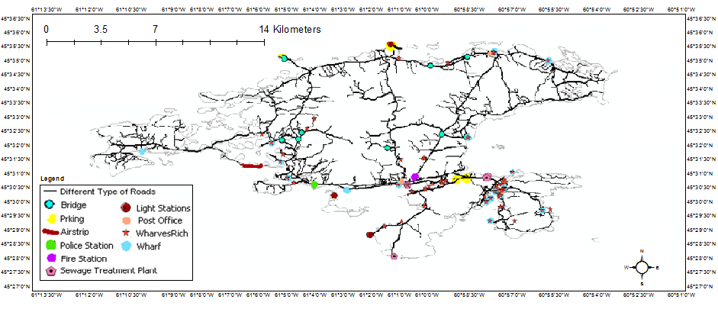
Profiling - Examples

Slide 24
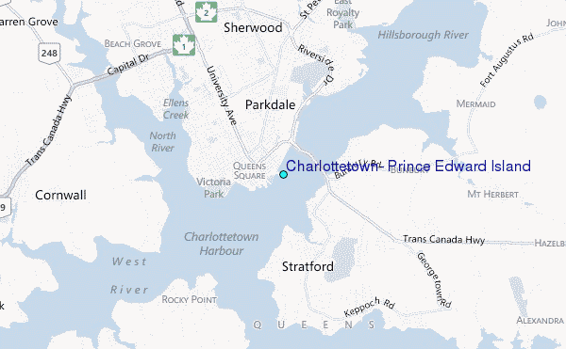
City of Charlottetown

Slide 25
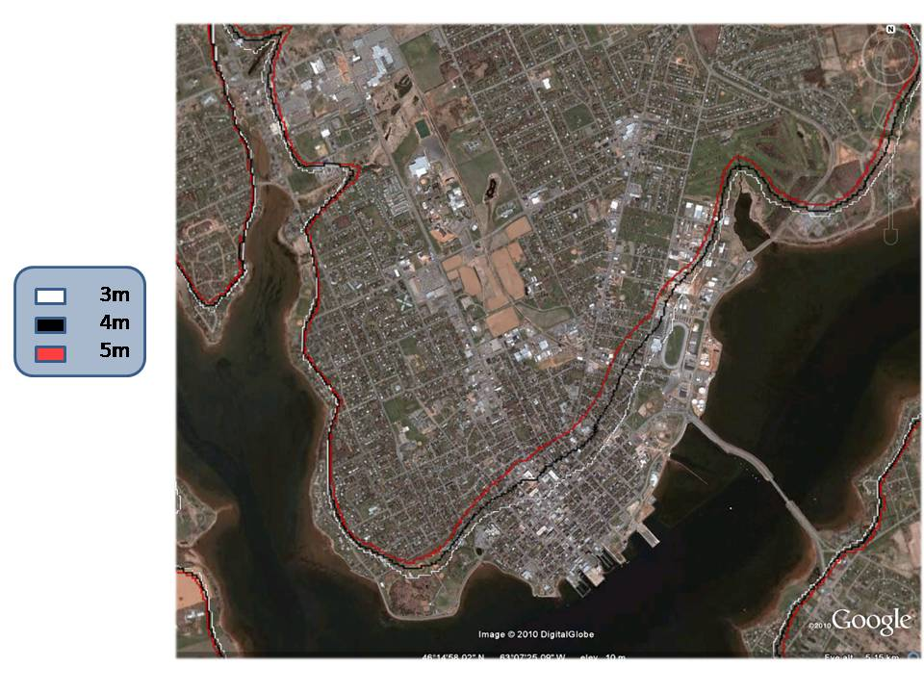
Charlottetown Spatial/GIS Model
Scenario | MOWL (m)
I | 2-2.5
II | 2.5-3
NN1962 | 2.55
III | 3-3.5
Juan | 2.93
IV | 3.5-4
V | 4-4.5
VI | 4.5-5
NN2000 | 4.22
Notes:
Mention reliability and completeness of Charlottetown tidal gauge
Best available data limited to 3 GIS flood lines;

Slide 26
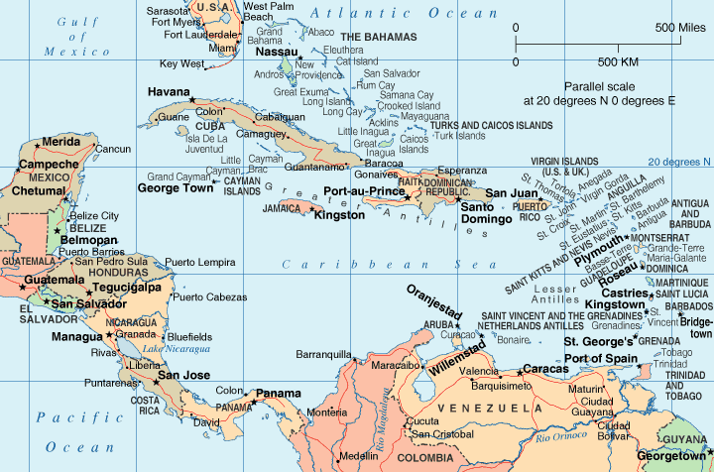
Bequia
Grand’Rivière

Slide 27
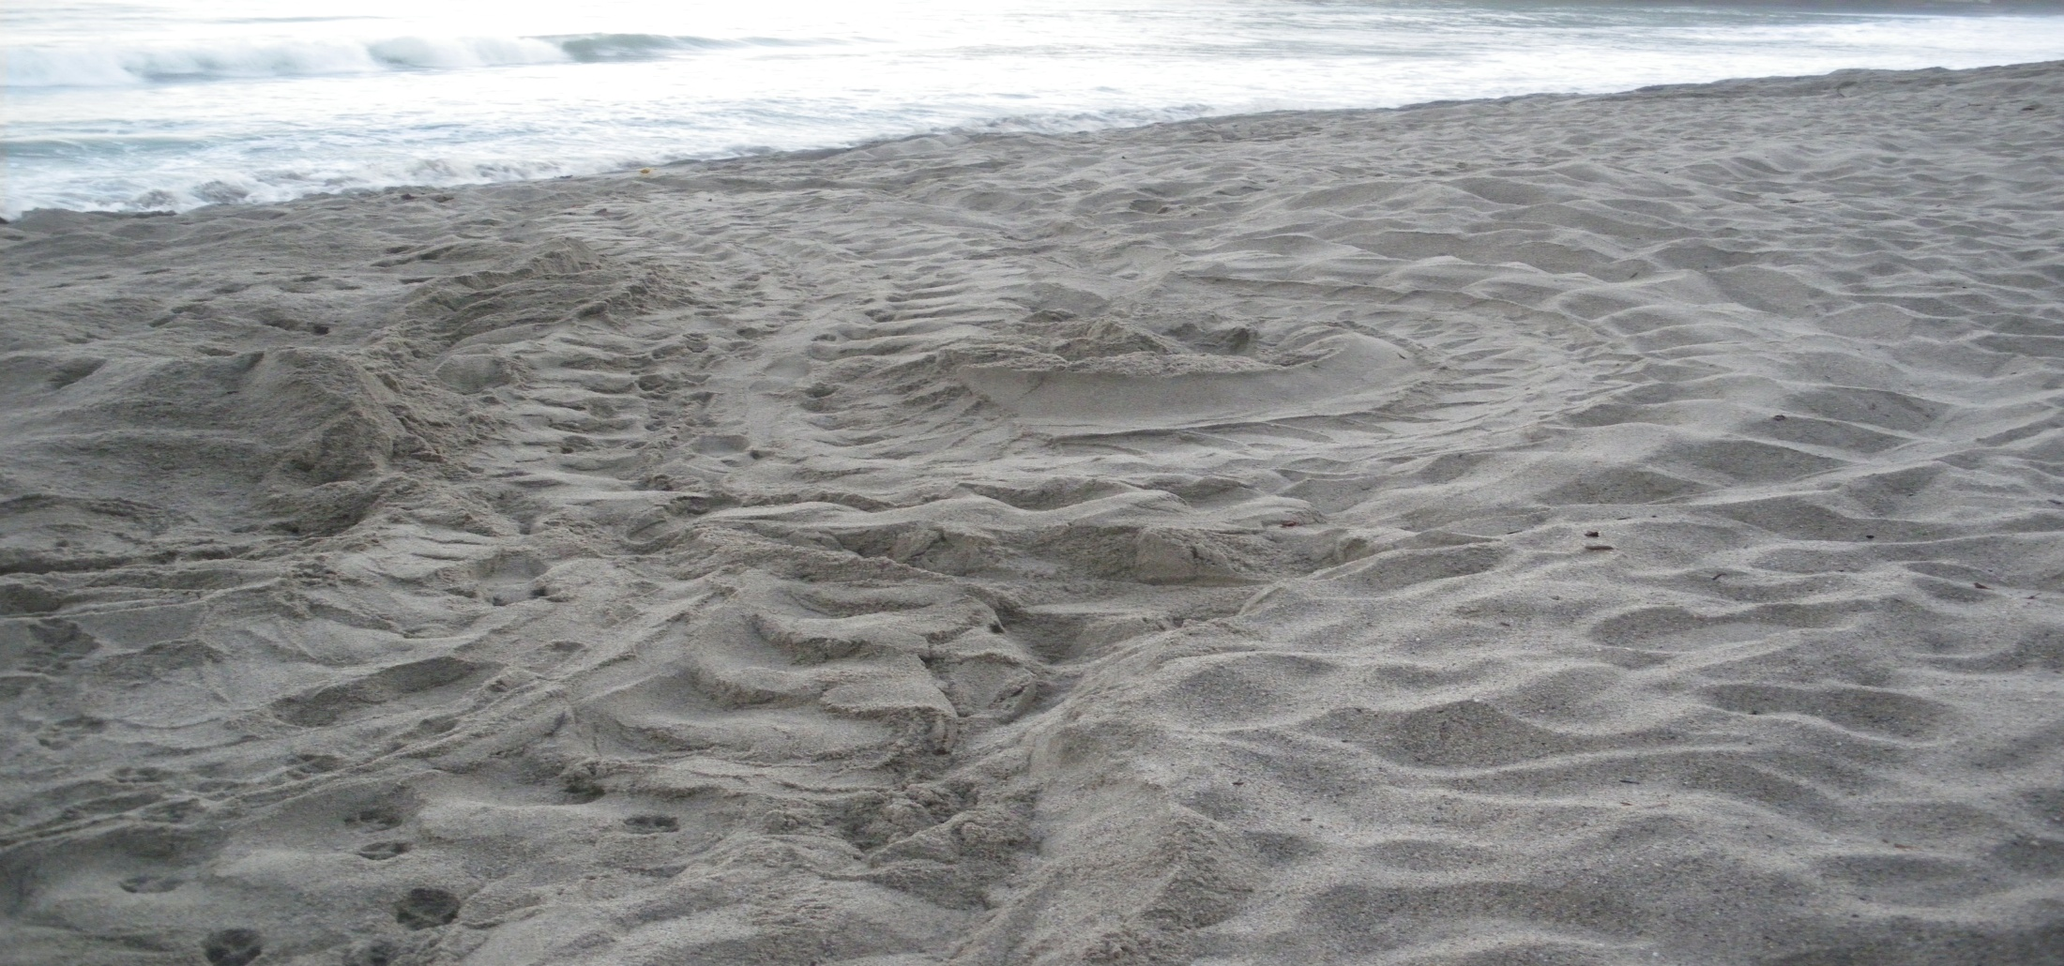
Grande Riviere, NE T&T –
Leatherback turtle tracks (March 22, 2010)

Slide 29
Tools
Geographical Information Systems – (GIS) is a system designed to capture, store, manipulate, analyze, manage, and present all types of spatial or geographical data.
  ArcGIS – Esri Mapping Systems
System dynamics - a computer-aided approach to policy analysis and design. It applies to dynamic problems arising in complex social, managerial, economic, or ecological systems — literally any dynamic systems characterized by interdependence, mutual interaction, information feedback, and circular causality.
  STELLA – ISEE Systems
  Vensim (Open source, free download)
MCDM – MultiCriteria Decision Making - Problems characterized by multiple stakeholders, community participants, many and conflicting criteria (environmental, economic, social)
  AHP – the Analytic Hierarchy Process (Saaty)

Slide 30
Adaptation Problem Solving
Profile the Community (Problem Definition & Data)
  GIS, local issues, key participants, identify community preferences, pairwise comparison (tradeoffs) - AHP
Assess Vulnerability “hotspots” (Data Analysis)
  Determine potential impacts based on historical events, develop adaptation alternatives and options, costs
Simulate Strategic Systems (Modelling & Analysis)
  System dynamics modelling, strategic planning period
Evaluate Strategy Alternatives
  Apply indices for Vulnerability, Resilience, Adaptive Capacity
Recommend, Implement & Monitor

Slide 31
Profiling Communities
Community preferences
  Ecological, economic, social, cultural
Recognition of assets
  Natural, industrial, demographic, cultural
History of storm events and impacts
  Hurricanes, high wind and snow/rain events
Sources of community vulnerability

Slide 32
4. Pillars of Sustainability

Slide 33
Community Profile – 4 Pillars of Sustainability (ICSPs)
 | Dimension | Sub-categories
1 | Environmental | Topography, Land and Marine Use, Natural Resources, Climate
2 | Economic | Employment, Industry, Property, Occupation, Revenues, Earnings, Public Works, Built Environment
3 | Social | Population, Health, Education, Communications, Community Dynamics, Governance
4 | Cultural | Places, Groups, Events, Language

Slide 34
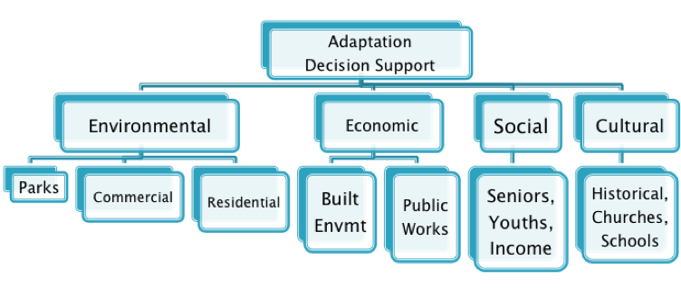
Coastal Community Adaptation Problem Hierarchy

Slide 35
How to compare the relative importance of problem elements?
Pairwise comparison exercise
Example: Community Profile Dimensions – Environmental, Economic, Social and Cultural
 | Economic | Social | Cultural
Environmental | Value1 | Value2 | Value3
Economic | - | Value4 | Value5
Social | - | - | Value6

Slide 36
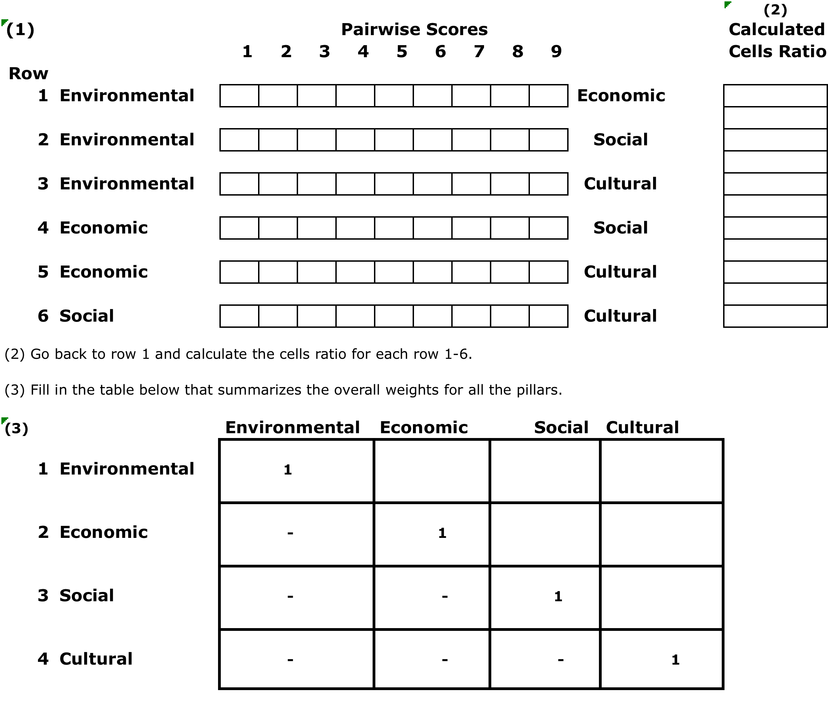
MCDM Worksheets (Handout

Slide 37
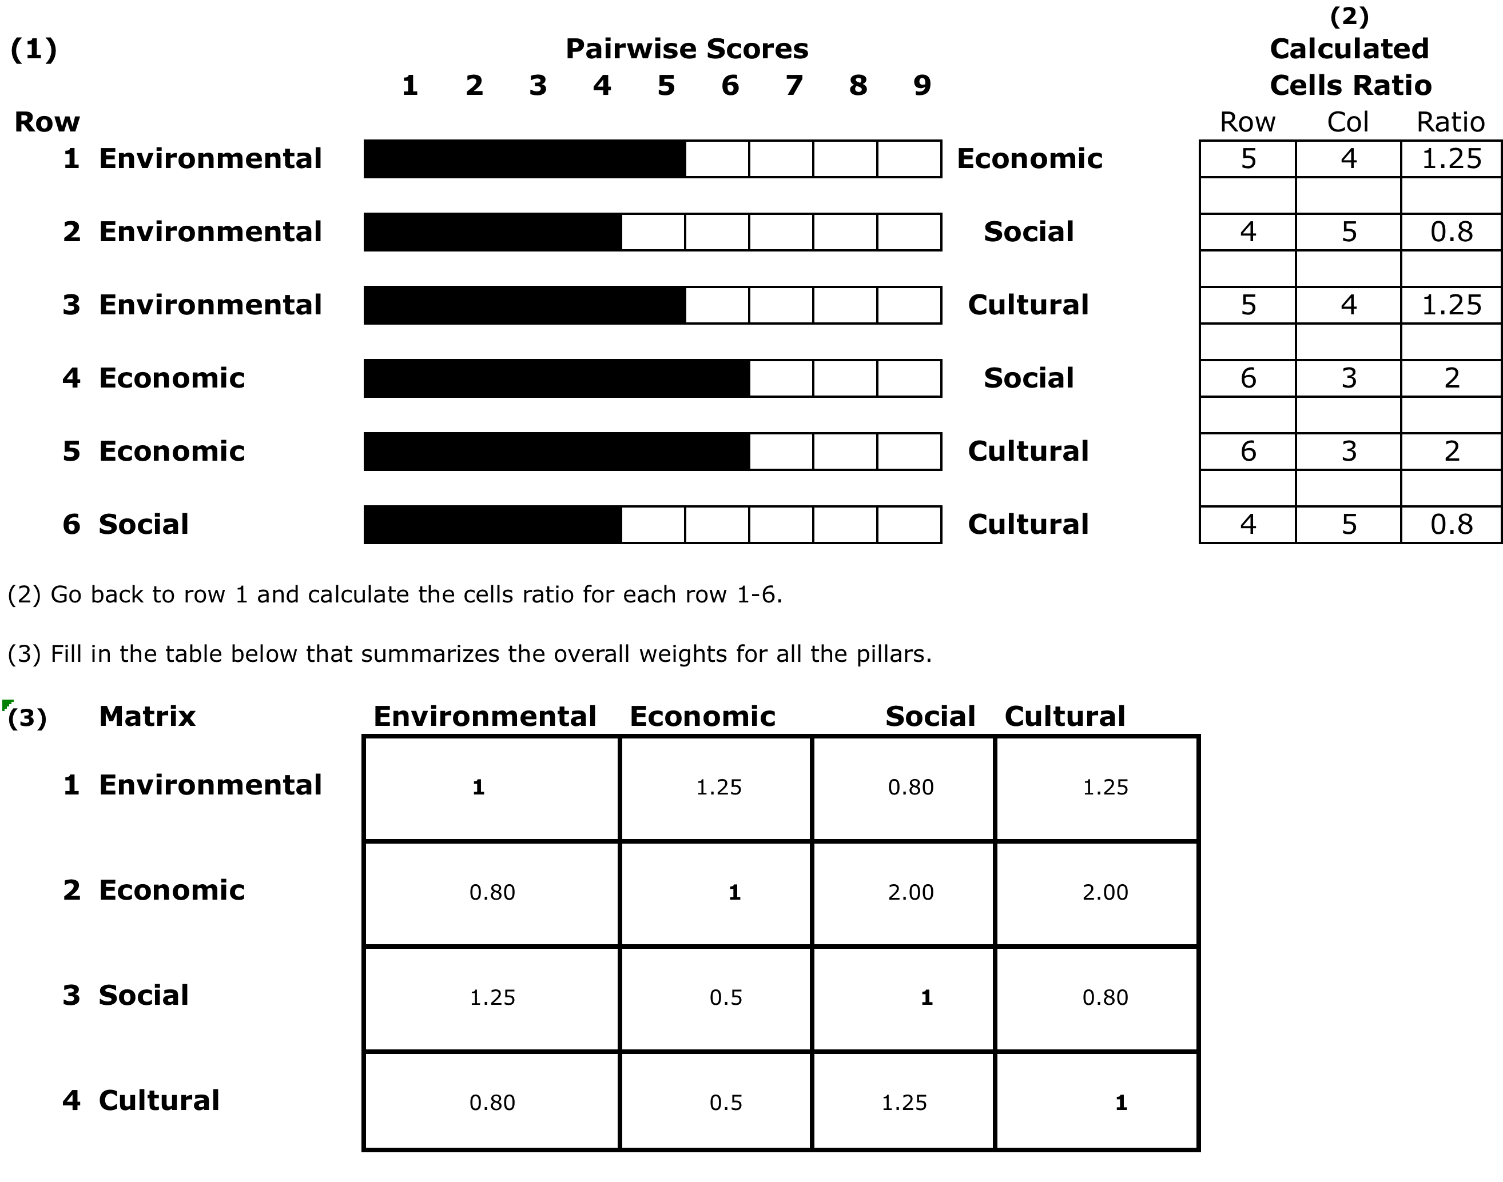
MCDM Worksheet Worked Example

Slide 38
Participants’ Preferences/Profiling Exercise

Slide 39
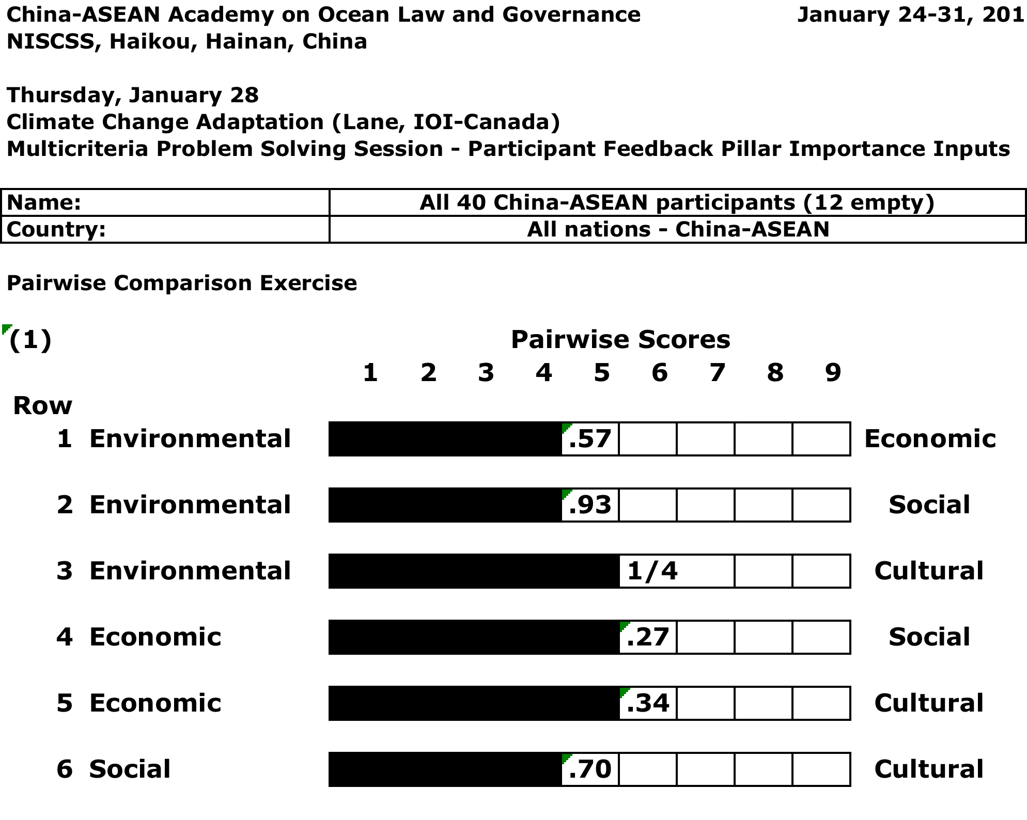
China-ASEAN Academy 1 (January 2016)

Slide 40
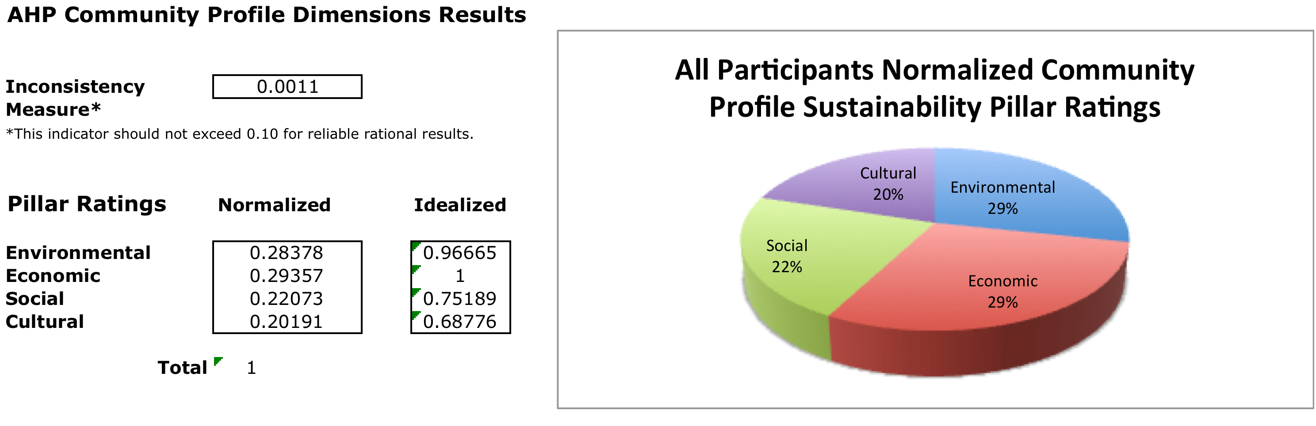
China-ASEAN Academy 1 (January 2016)

Slide 41
China-ASEAN Academy 1 (January 2016)

Slide 42
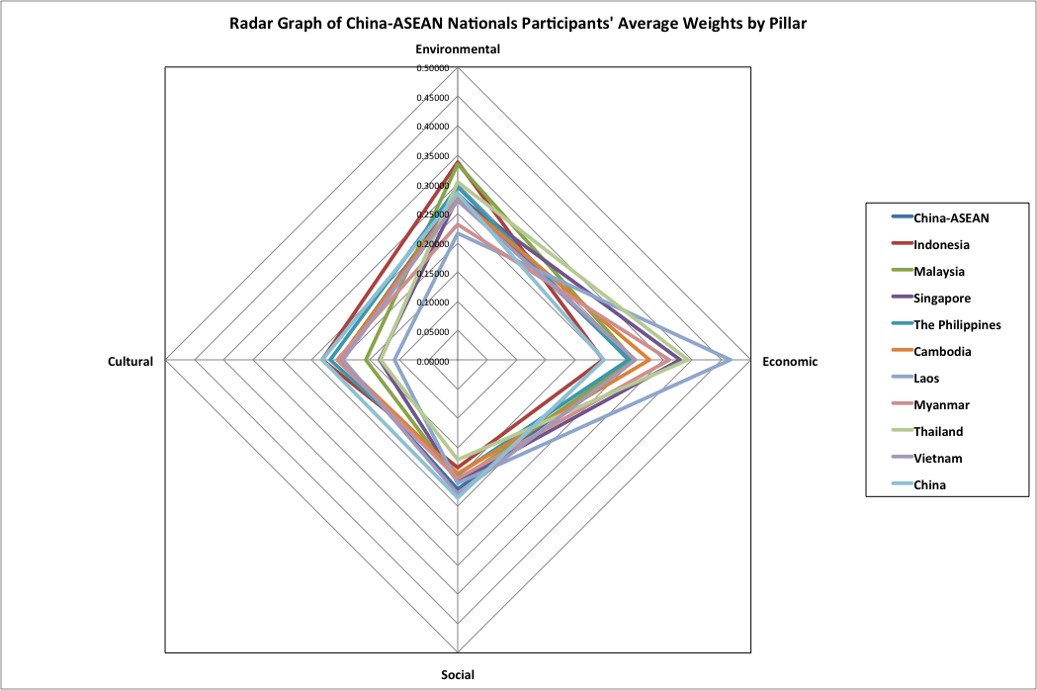
China-ASEAN Academy 1 (January 2016)

Slide 43
Little Anse Case Study
Pairwise Comparison Trade-offs (Input):
 | Economic | Social | Cultural
Environmental | 1.3 | 1.0 | 1.25
Economic | - | 1.3 | 1.5
Social | - | - | 1.0
Corresponding Criteria Weights (Output):
Environmental | Economic | Social | Cultural
0.28 | 0.27 | 0.24 | 0.21

Slide 44
Priorities & Multi-Participants
Community: representatives of the community at large
Local Government: representatives of local (municipal) government
Business/Industry: community industries
Professional: professionals providing service to the community, e.g., lawyers, doctors, nurses, engineers, etc.

Slide 45
Participants

Slide 46
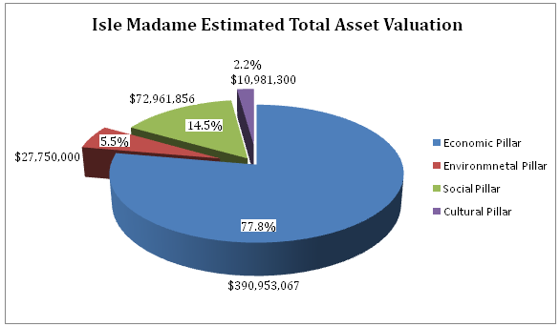
Isle Madame Asset (Pakdel 2011)

Slide 47
Break (Lunch!)

